Slide 1
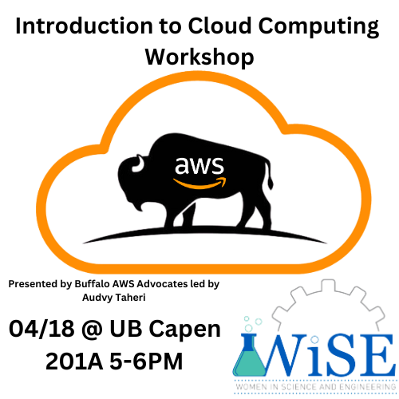

Scan to sign in

Slide 2
What is the Cloud?
Scan to sign in

Slide 3
Someone else’s collection of computers you access over the internet
Scan to sign in

Slide 4
They give you varying abstractions of accessing those computers
Scan to sign in

Slide 5
What do I mean?
Scan to sign in

Slide 6
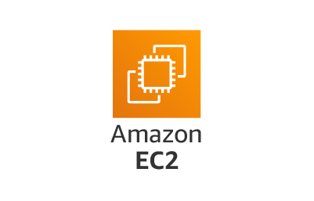
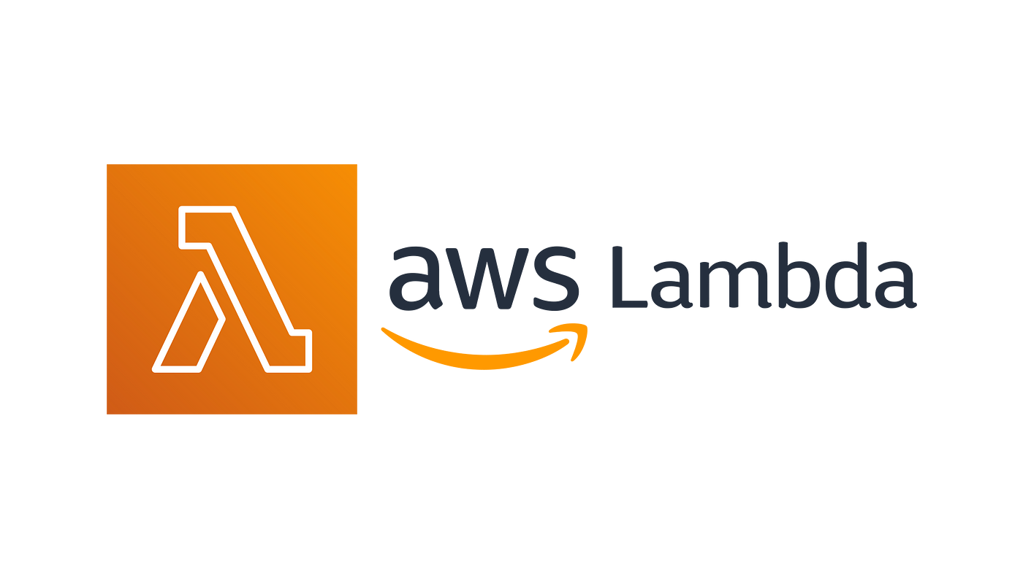
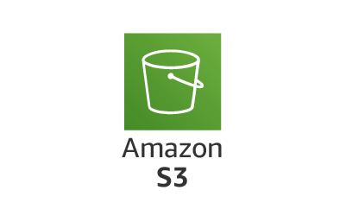



No abstraction
Partial abstraction
Full abstraction
Scan to sign in
*my terminology for educational purposes
Amazon DynamoDB

Slide 7
You can use their computers to do a lot
Scan to sign in

Slide 8
Why would we use the cloud?
Scan to sign in

Slide 9
Agility
High availability
Scalability
Variable Expenses
Scan to sign in

Slide 10
Agility
High availability
Scalability
Variable expenses
Agility
The speed of deploying resources

Slide 11
Agility
High availability
Scalability
Variable expenses
Agility
The speed of deploying resources
High availability
The uptime of your app’s components

Slide 12
Agility
High availability
Scalability
Variable expenses
Agility
The speed of deploying resources
High availability
The uptime of your app’s components
Scalability
How your app’s components can scale to meet demand

Slide 13
Agility
High availability
Scalability
Variable expenses
Agility
The speed of deploying resources
High availability
The uptime of your app’s components
Variable expenses
Scalability
How your app’s components can scale to meet demand
Trading fixed expenses for variable expenses

Slide 14
Scalability

Slide 15
Vertical Scalability
Horizontal Scalability
Upgrade the underlying server hardware
Utilize more servers to process requests

Slide 16
Why not just do this on-prem?

Slide 17
Agility
High availability
Scalability
Variable expenses
Agility
The speed of deploying resources
High availability
The uptime of your app’s components
Variable expenses
Scalability
How your app’s components can scale to meet demand
Trading fixed expenses for variable expenses

Slide 18
Which companies offer cloud services?

Slide 19




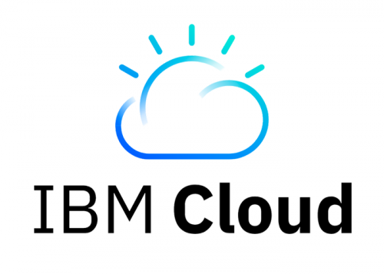
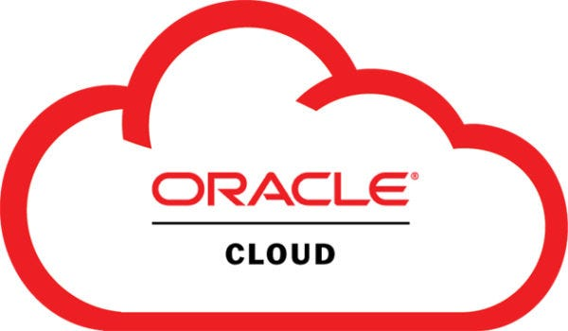

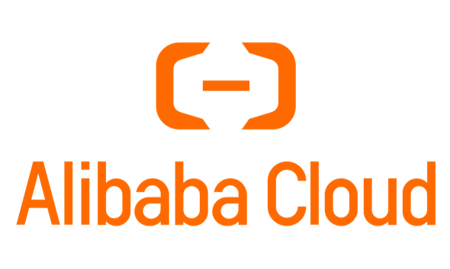

Slide 20
Related companies

Slide 21



Content delivery network & more:
Wrappers around other cloud providers:

Slide 22
How is AWS organized?

Slide 23
Region
Availability Zone
Data Center

Slide 24
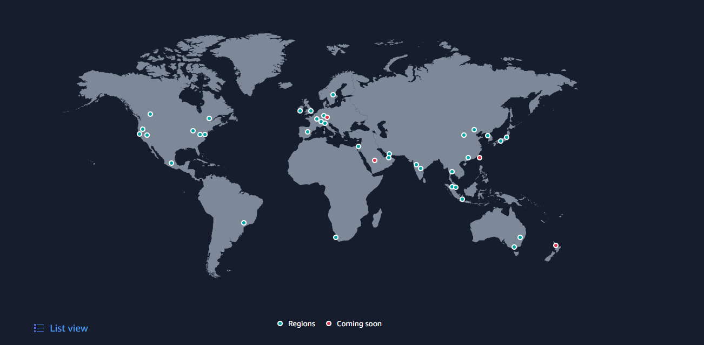

Slide 25
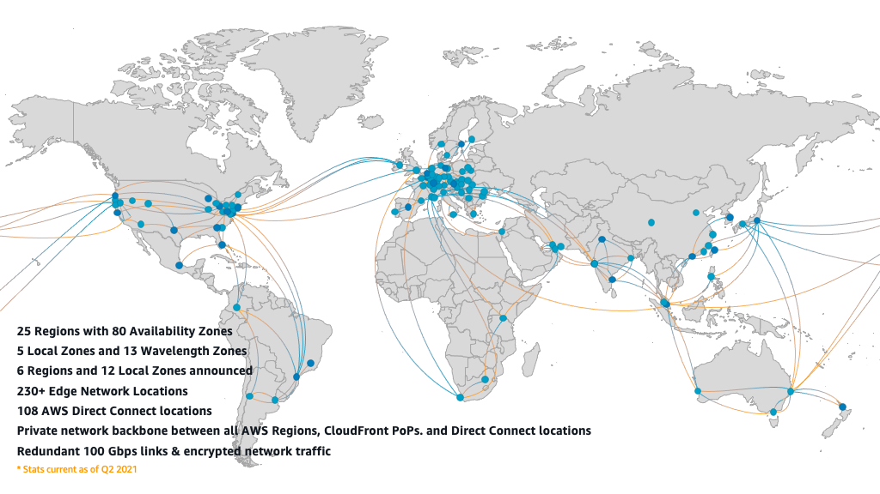

Slide 26
Some regions are:
us-east-1 (Virginia)
eu-west-2 (London)
ap-northeast-1 (Tokyo)
ap-south-1 (Mumbai)

Slide 27
Our closest region is us-east-2 (Ohio)

Slide 28
Each region is made up of 3 or more availability zones
Spread out across the region

Slide 29
Each availability zone is made up of 1 or more discrete data centers

Slide 30
us-east-2 has 3 availability zones:
us-east-2a
us-east-2b
us-east-2c

Slide 31
5th benefit of the AWS specifically:
The Global Network

Slide 32
AWS can be split up into 4 categories
*my terminology for educational purposes

Slide 33
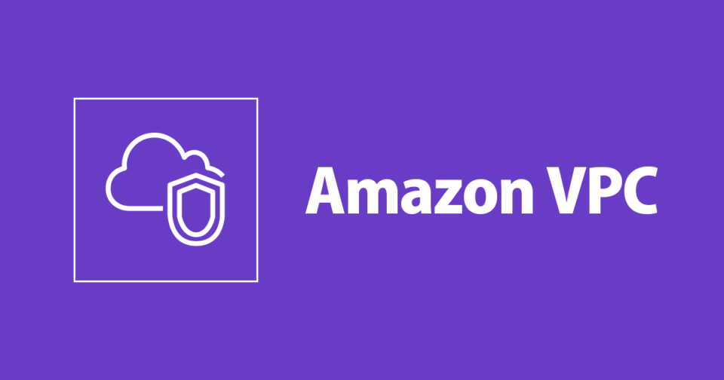
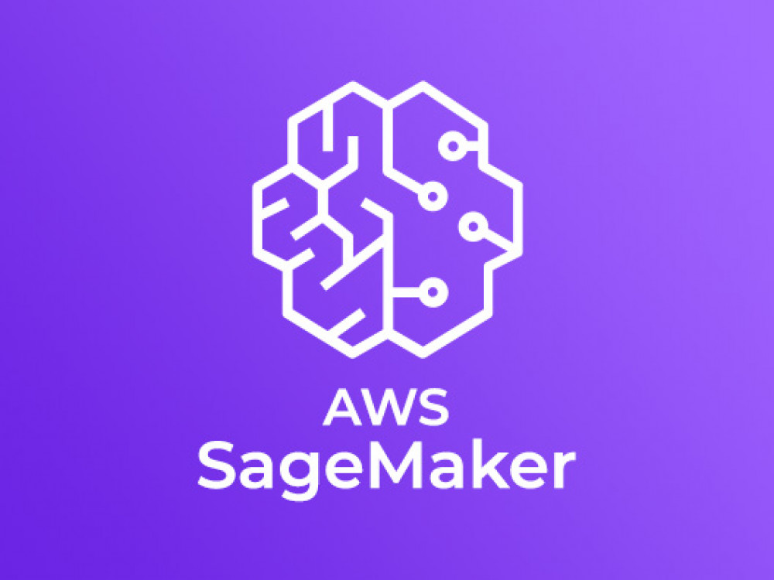


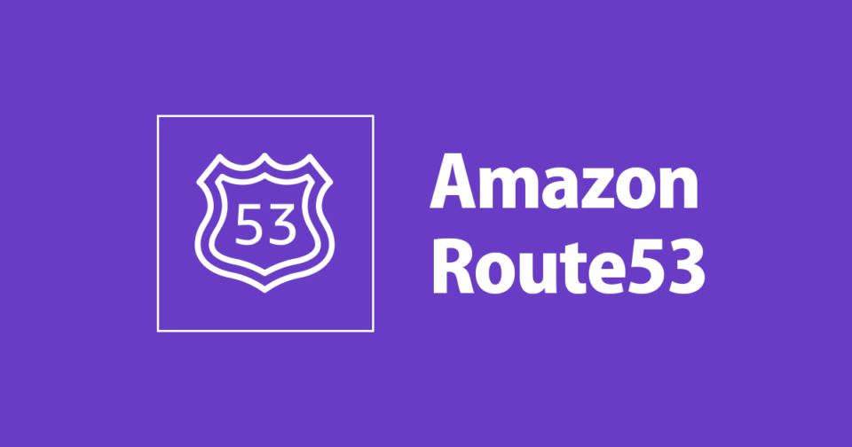
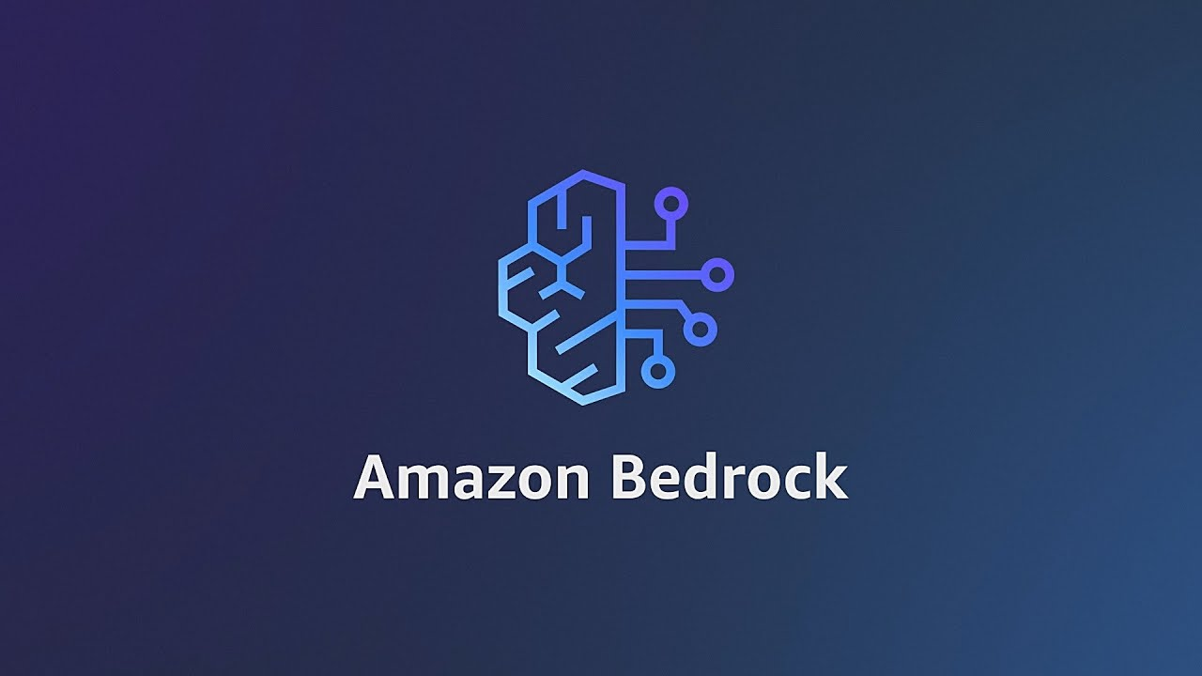
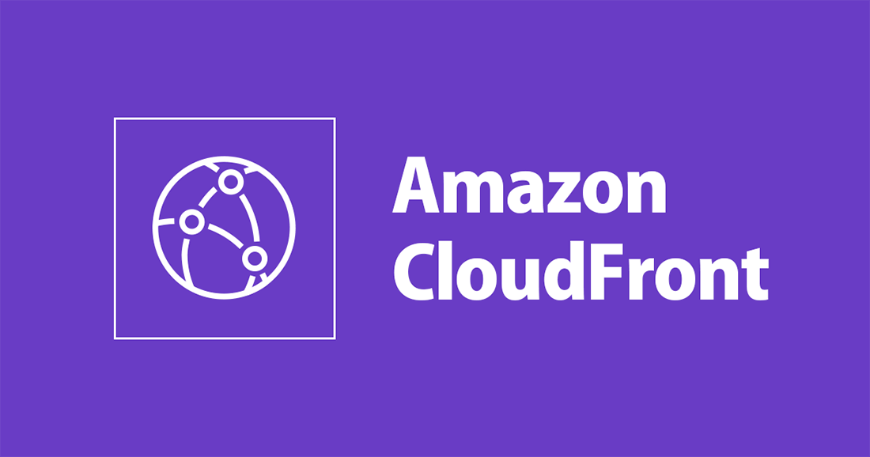


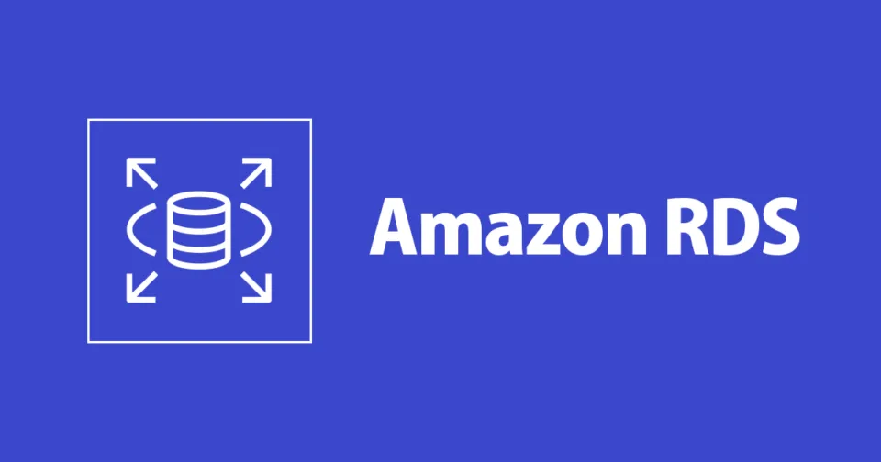


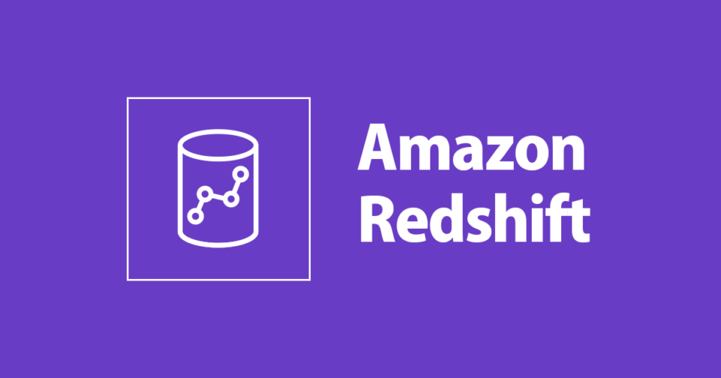
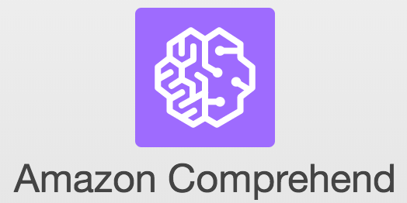
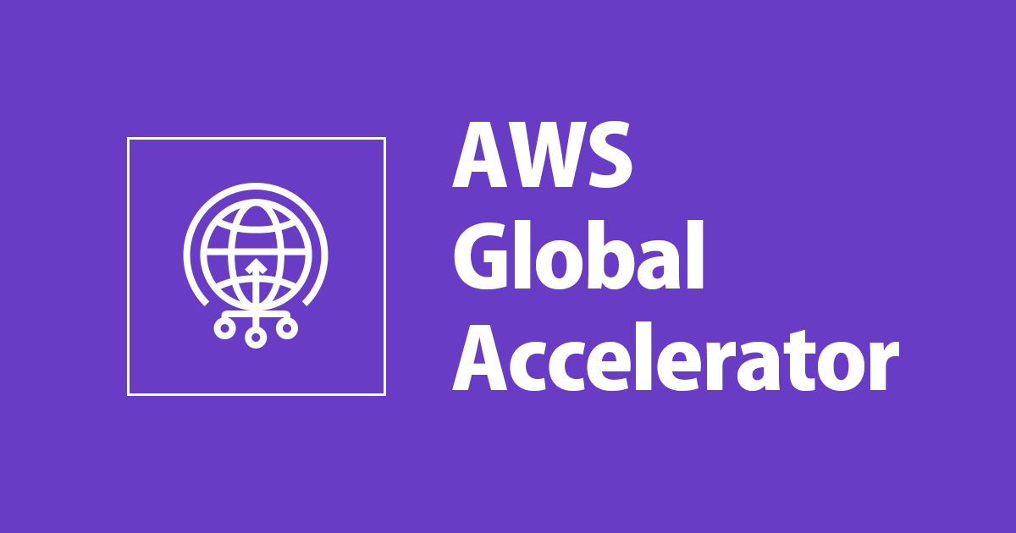
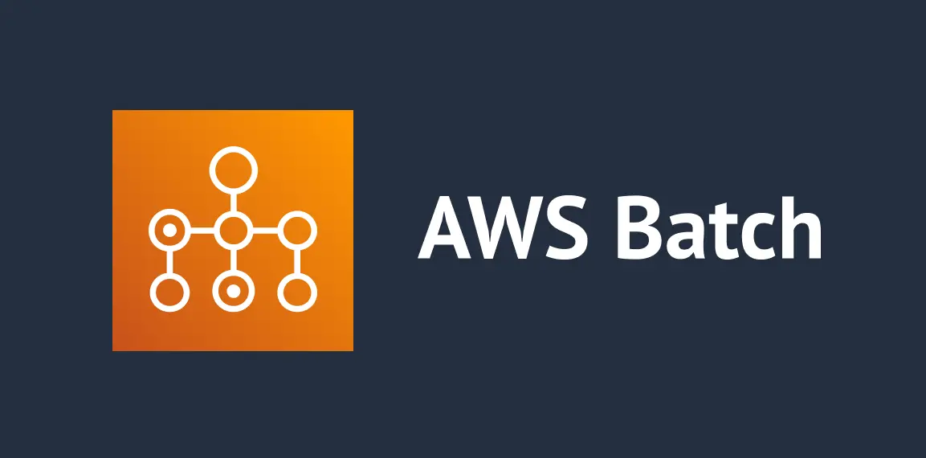
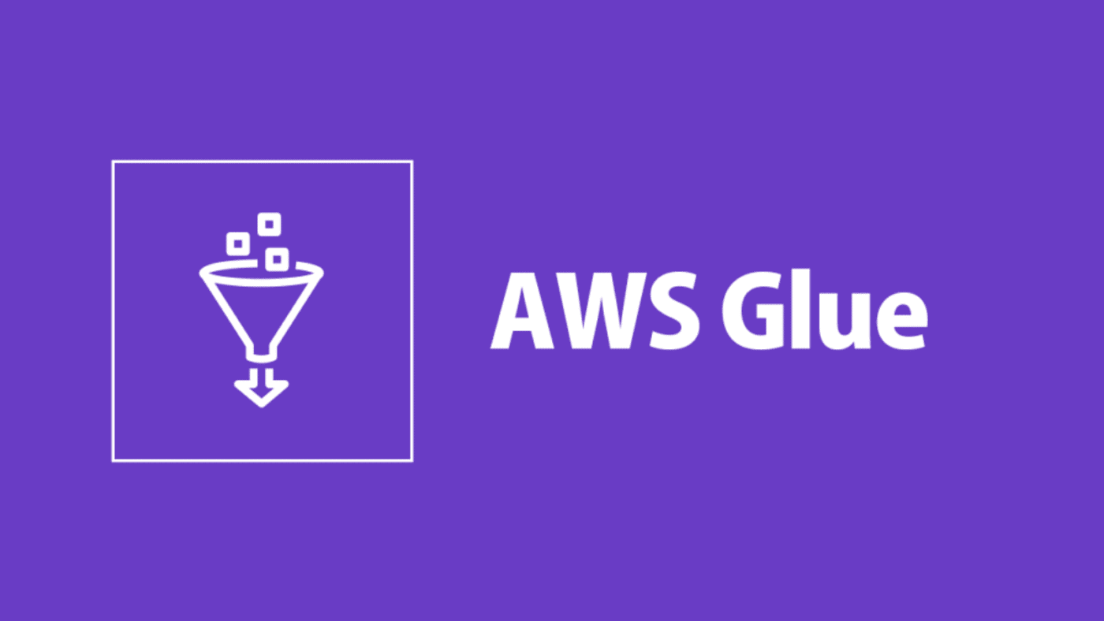
Compute
Data
Network
AI
*my terminology for educational purposes
AWS Aurora Serverless
Amazon DynamoDB
Elastic Container Service
AWS API Gateway
AWS Elastic Kubernetes Service

Slide 34

Identity and Access Management
Create users and roles with assigned permissions
Best practice:
DONT USE YOUR ROOT ACOUNT!!!

Slide 35
Primer on AWS Compute

Slide 36

EC2
Virtual computer in the cloud
Can SSH into them for access (or use Systems Manager)
Can launch with most OSes (including macOS!)

Slide 37
On Demand
Reserved
Start and shut down only when you want
Reserve an instance for 1 or 3 years
Dedicated Hosts
Dedicated Instances
Spot
Cheaper instances that can be shut down if someone outbids you
A entire static physical server rack is fully controlled by one customer
You are given a random server rack dedicated to your account (no control)

Slide 38


Auto scaling groups
Elastic Load Balancer
Automatically provisions and deletes EC2 instances to handle traffic
Automatically distributes requests to EC2 instances

Slide 39
Security Groups
Stateful firewalls around EC2 instances

Slide 40

Lambda
Execute snippets of code in the cloud
Supports 5 different languages (or any if you provide runtime)

Slide 41

Elastic Container Service
Orchestrates your docker containers

Slide 42
EC2 Launch Type
Fargate Launch Type
Runs Docker Containers on EC2 instances
Runs Docker Containers serverlessly

Slide 43

Batch
Orchestrates batch jobs based on Docker image

Slide 44
Primer on AWS Data Services

Slide 45

S3
Storage bucket
Can be used to host static websites
http://bucket-name.s3-website.Region.amazonaws.com
Infinitely scales

Slide 46

Athena
Run SQL queries against S3

Slide 47
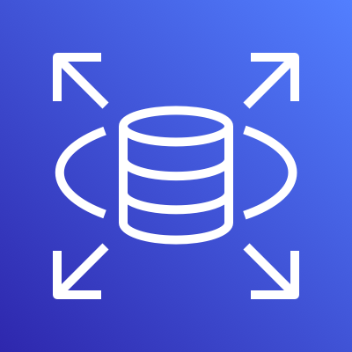
Aurora
Relational Database Service
AWS-Optimized Cloud Native SQL Database Engine
Serverless Option
Managed Database in the cloud
Runs on EC2 instances
Compatible with:
MySQL
PostgreSQL
MySQL
PostgreSQL
MariaDB
Oracle
Microsoft SQL Server
IBM DB
Aurora

Slide 48

DynamoDB
Serverless NoSQL Database
Max element size is 400KB
Primary ID and optional Sort ID

Slide 49
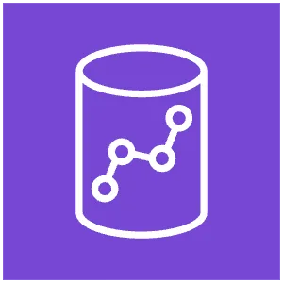
Redshift
Data Warehouse
Analyze Petabytes of data
Provisioned or serverless clusters

Slide 50

Kinesis Data Streams
Collect and store real time data streams

Slide 51

Kinesis Firehose
Perform Transformations on real time streams and store in destination

Slide 52
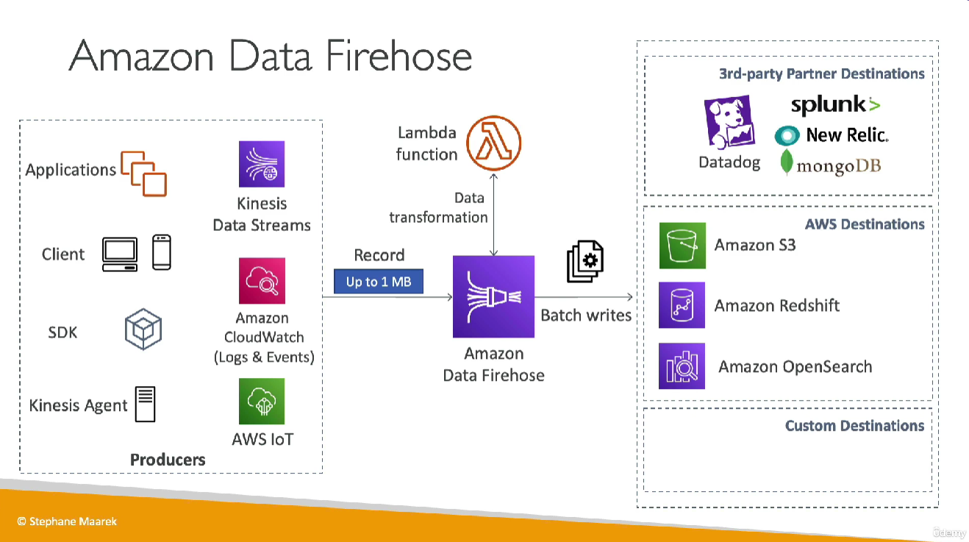
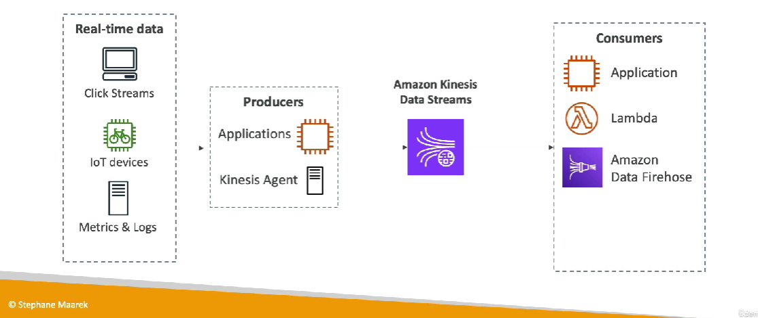
Data streams
Firehose
Credit to Stephane Maarek (https://www.udemy.com/course/aws-certified-solutions-architect-associate-saa-c03/learn/lecture/13528462#overview) (https://www.udemy.com/course/aws-certified-solutions-architect-associate-saa-c03/learn/lecture/33907160#overview)

Slide 53

Glue
Perform ETL on Data
Takes data from a source and loads it in a destination
Can convert to Parquet (Columnar) for performance

Slide 54

Elastic MapReduce
AWS Fully Managed Hadoop in the Cloud

Slide 55
Primer on AWS Networking Services

Slide 56

Virtual Private Cloud
Your own Region-wide “Wifi network” in the cloud

Slide 57
Subnets
Availability-Zone-wide subnetworks
Can be public or private

Slide 58
CIDR Ranges
Notation to express sets of IP addresses

Slide 59
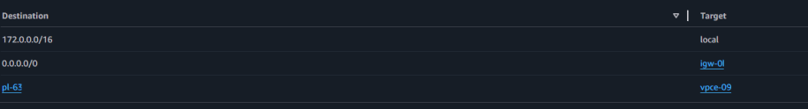
Route Tables
Rules of which traffic to deliver where

Slide 60
VPC Endpoints
Accessing your AWS resources without public internet

Slide 61



Firewalls
Network Firewall
VPC level
Can be either
Network Access Control List (NACL)
Subnet level
Stateless
Security Groups
EC2 Level
Stateful

Slide 62

Route53
AWS DNS Registrar
Assign routes to records

Slide 63

Cloudfront
Content Delivery Network
Takes advantage of AWS Global Network

Slide 64

Global Accelerator
Routes traffic through private AWS networks
Takes advantage of AWS Global Network

Slide 65
API Gateway
Create APIs instantly
HTTP
RESTful
WebSocket

Slide 66
Primer on AWS ML Services

Slide 67

Sagemaker
Suite of tools to build datasets, and develop, train, compare, and deploy ML models

Slide 68

Bedrock
Provides LLMs from many companies you can use
Llama
Mistral
Jurassic
DeepSeek
Claude
…many more!!
Can fine tune or do continued pre-training on these models

Slide 69
Retrieval Augmented Generation (RAG)
Create “knowledge bases” that the LLM can reference from
S3
Redshift
Web Crawlers
Custom Source
…also many more!!

Slide 70

Comprehend
Natural Language Processing Model
Perform Sentiment Analysis
Remove PII
Extract key phrases
…and also many more!!
Has a Medical version

Slide 71


Rekognition
Object detection
and image/video analysis

Slide 72
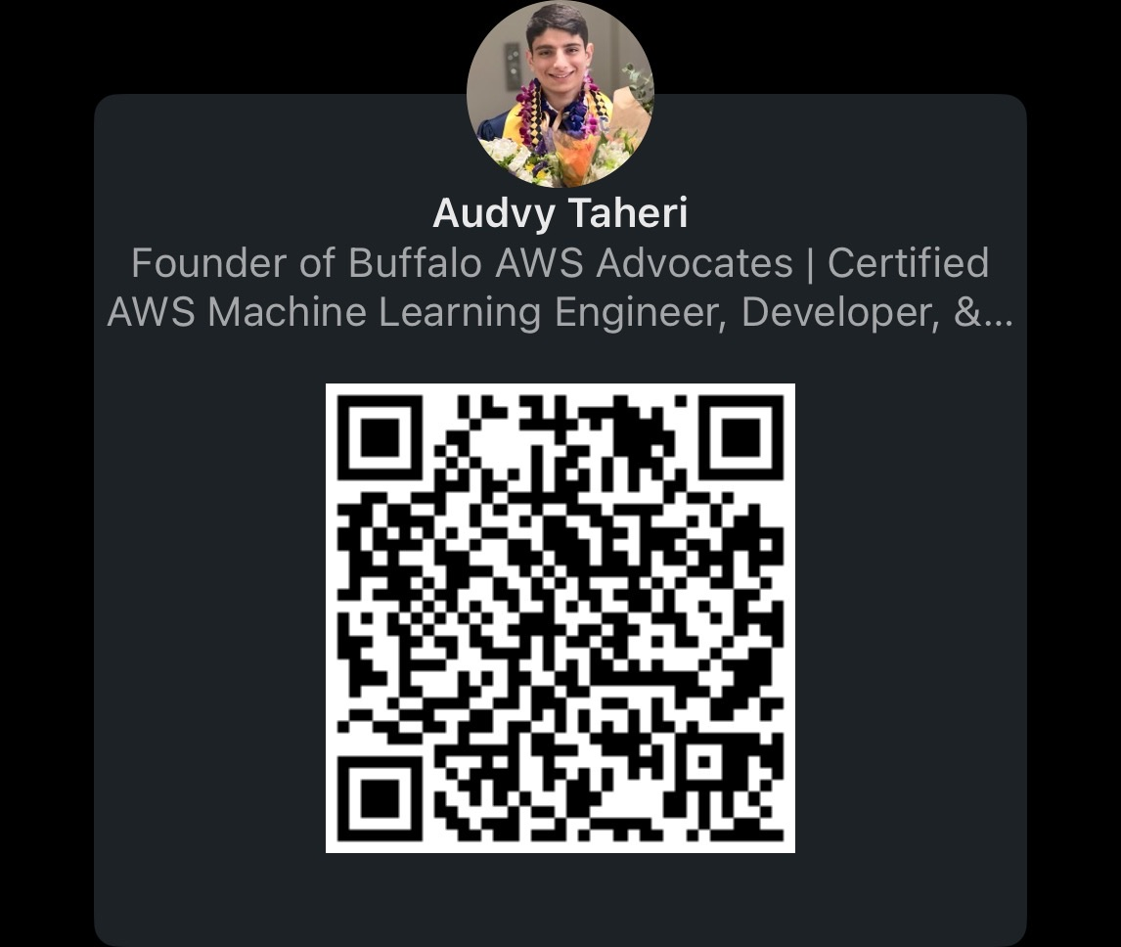
Connect with me!
https://www.linkedin.com/in/audvy/

Slide 73
Further readings & Sources
https://docs.aws.amazon.com/whitepapers/latest/aws-overview/six-advantages-of-cloud-computing.html
https://vercel.com/
https://www.netlify.com/blog/2018/03/20/netlifys-aws-lambda-functions-bring-the-backend-to-your-frontend-workflow/
https://aws.amazon.com/ecs/
https://www.udemy.com/course/aws-certified-developer-associate-dva-c01/learn/lecture/11851260#overview
https://cloud-icons.onemodel.app/aws/architecture_service_icons/

